Slide 1



Galaxy Zoo:
Deep Learning with Uncertainty
Mike Walmsley, University of Oxford
zooniverse.org
@the_zooniverse
@mike_w_ai
Notes:
Hi. I’m Mike. I help run Galaxy Zoo, a website where anyone in the world can label the morphologies of galaxies.
Our goal is to take every galaxy and say something about it’s morphology. The more galaxies we label, the more specific questions we can ask. When we want to know what fraction of low-mass barred spiral galaxies host AGN, suddenly it really matters that you have a lot of labelled galaxies to divide up.
Unfortunately -

Slide 2
Galaxy Zoo has a problem.
Notes:
- Galaxy Zoo has a problem.
Our problem is that * * Humans * * don’t * * scale * *. Surveys keep getting wider and deeper, but there will never be a Galaxy Zoo Phase 2 with a larger mirror. We’ll always have about the same order of magnitude of volunteers as we do now. Here’s what that means.

Slide 3
Scale
Something
Galaxies / day
How many galaxies do we need to handle?
Currently
2019
Notes:
This is how fast we’re going through galaxies now. This is how fast we need to be going through galaxies to finish all the surveys we’d like in the next year.
Now. When LSST starts in around 2021, we'll need to be working this fast.

Slide 4
Scale
Something
Galaxies / day
How many galaxies do we need to handle?
Currently
2019
2021
Notes:
*pause*
Either LSST will give us the largest, richest set of morphology measurements to date – or it won’t, because we won’t be able to keep up.
Dealing with this is my job. I write my thesis around here *point to 2020*. So when I said -

Slide 5
Galaxy Zoo has a problem.
Notes:
- Galaxy Zoo has a problem…

Slide 6
Galaxy Zoo has a problem.
Mike
Notes:
- I really meant that I have a problem!
*pause*
So how can I solve it? I have a few ideas to show you, and I’d really like to know what you think because I need to make this work.
[2 – 2.5 mins]

Slide 7
1. Now(ish): Human → Model
Notes:
The first approach I could take is to treat this as a classic data science problem. I have some labelled galaxies to train on, and I’d like to build a model to predict the rest. Human labels, feeding a model. I put ”now” here because this is something I’ve already done some work on.

Slide 8
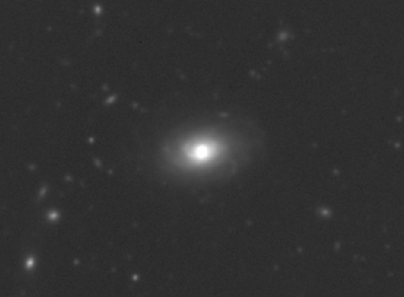
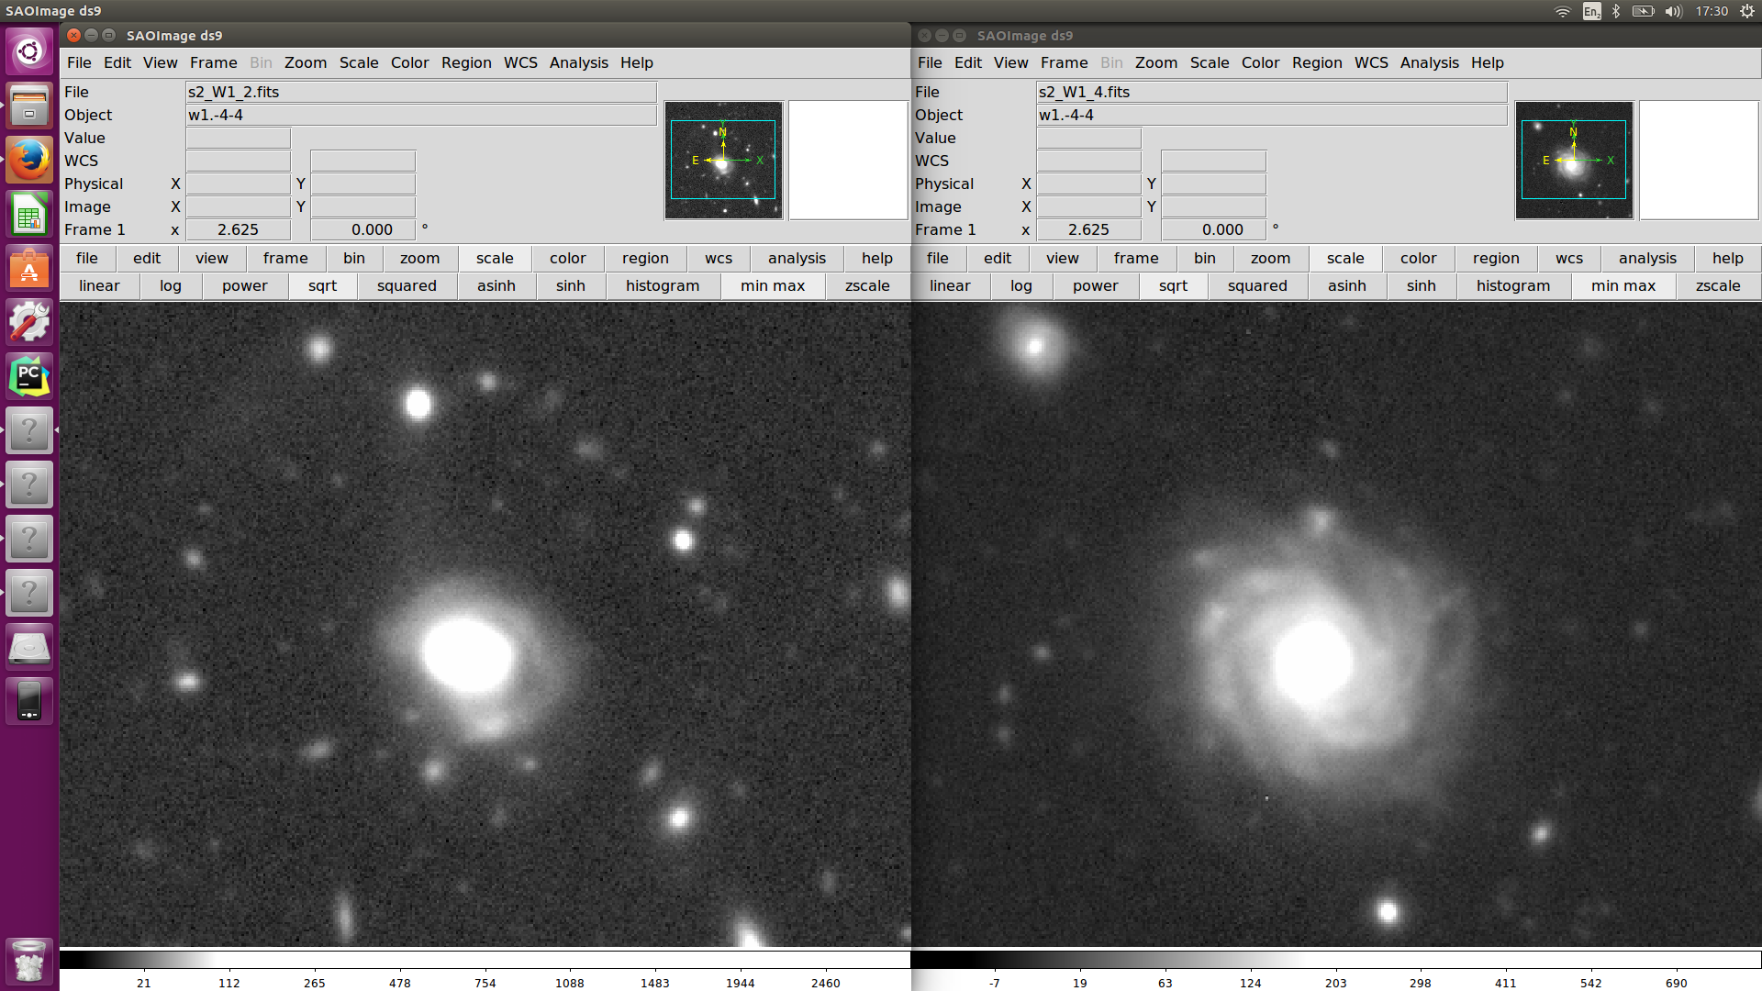
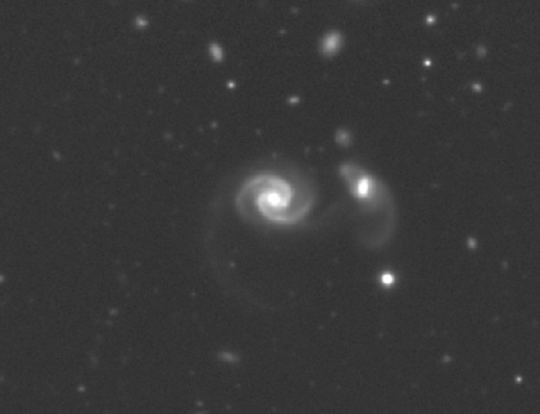
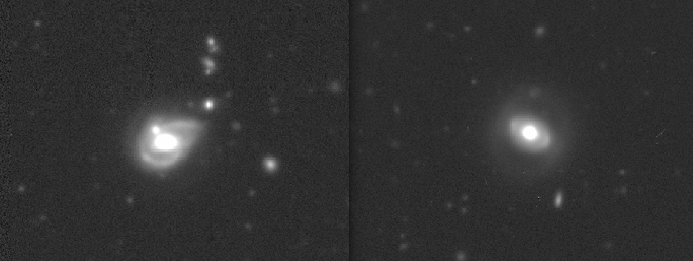
Notes:
Before I joined the Galaxy Zoo team, I was challenged to find a way to automatically identify low surface brightness tidal features.
I was given a catalog of 2000 galaxies that had been labelled by eye. My task was to replicate those 2000 labels automatically.
Here’s some of the galaxies I had to classify. The images are from the Canada-France-Hawaii Telescope. The first thing that you’ll notice is that they’re deep. g-band limiting magnitude of 27.7.
For eyes, deep images are great. You can see faint tidal features that indicate a merger happened.
point out the examples…This one is pretty obvious – you can see tails extending from both galaxies, and a bridge between them. Here, there’s possibly a tidal shell. And here, there’s a curious asymmetry in this arm-like structure.
For algorithms, though, deep images actually make things harder.
One method is to fit a light profile, subtract it off, and measure the residuals. If there’s lots of residuals, the galaxy is disturbed and probably a post-merger. That’s fine when you’re dealing with blobs – but fitting a model light profile to a flocculent spiral is not going to end well. All these bright arms will dominate the residuals over any real tidal features.
Another thing we could try is to handcraft some feature to measure. Perhaps the asymmetry. If the galaxy is highly asymmetric, it’s probably a post-merger. But what if you have a foreground or background source? You’d better mask that really well. And what about this galaxy? It has a tidal shell – but it’s totally symmetric.
So neither of these methods is really suitable for galaxies with complex morphologies. It’s hard to write a set of rules that can consistently pick out tidal features.
Step forwards and sideways. Quietly: you know where this is going. Pause.
This is the point in the talk where the presenter usually introduces convolutional neural networks. They explain how they can learn the best rules directly from the data, and they work very well. Fine. You’ve seen this before. Instead – let me show you something more interesting.

Slide 9
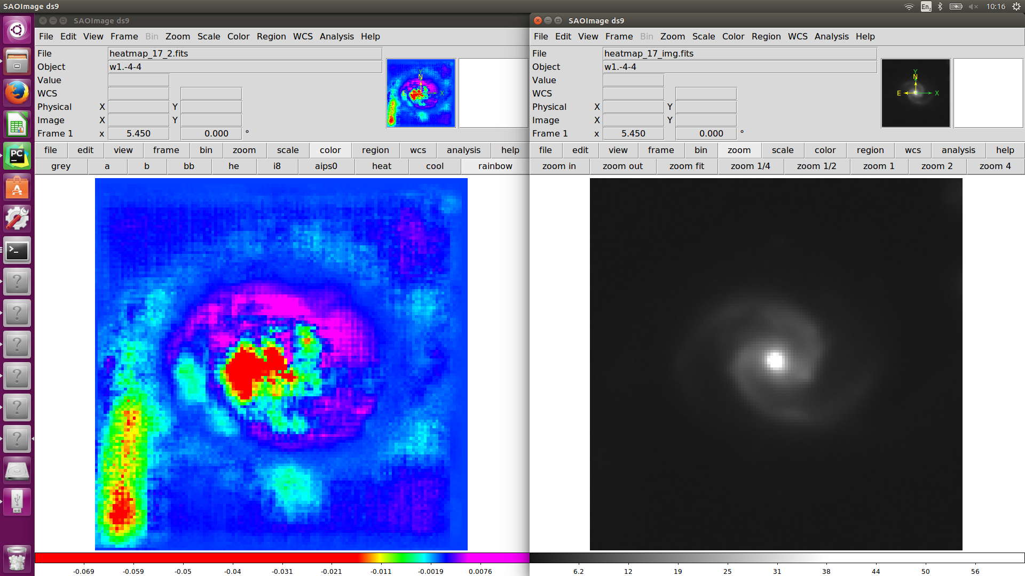
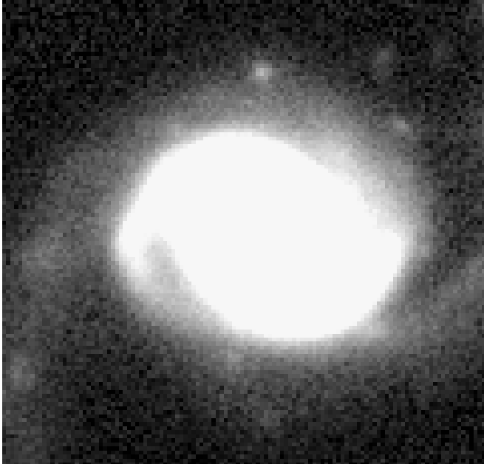
Tidal Feature Localisation
Original
Trained Heatmap
Original, Log Scale
Notes:
Neural networks can identify which parts of the image are tidal. Consider taking an image, painting in random structure within some small area, and reclassifying the image.
You can repeat this many times for different areas. When you plot the new classifications as a heatmap, you can see which parts of the original image the network considers to be tidal.
I think that’s quite cool. Not only can we classify images better, but we can start to make quantitative measurements of the shapes of tidal features.

Slide 10
1. Now(ish): Human → Model
Notes:
Detecting mergers is an example of this first approach: given some human labels, build a model that predicts labels for new galaxies.
But it’s not the only approach. Here’s another one.

Slide 11
1. Now(ish): Human → Model
2. Human + Model?
Notes:
What if instead, we treat the humans and the model as two separate classifiers, working together? To see what that’s like, let me show you some work by Darryl Wright at Minnesota.

Slide 12
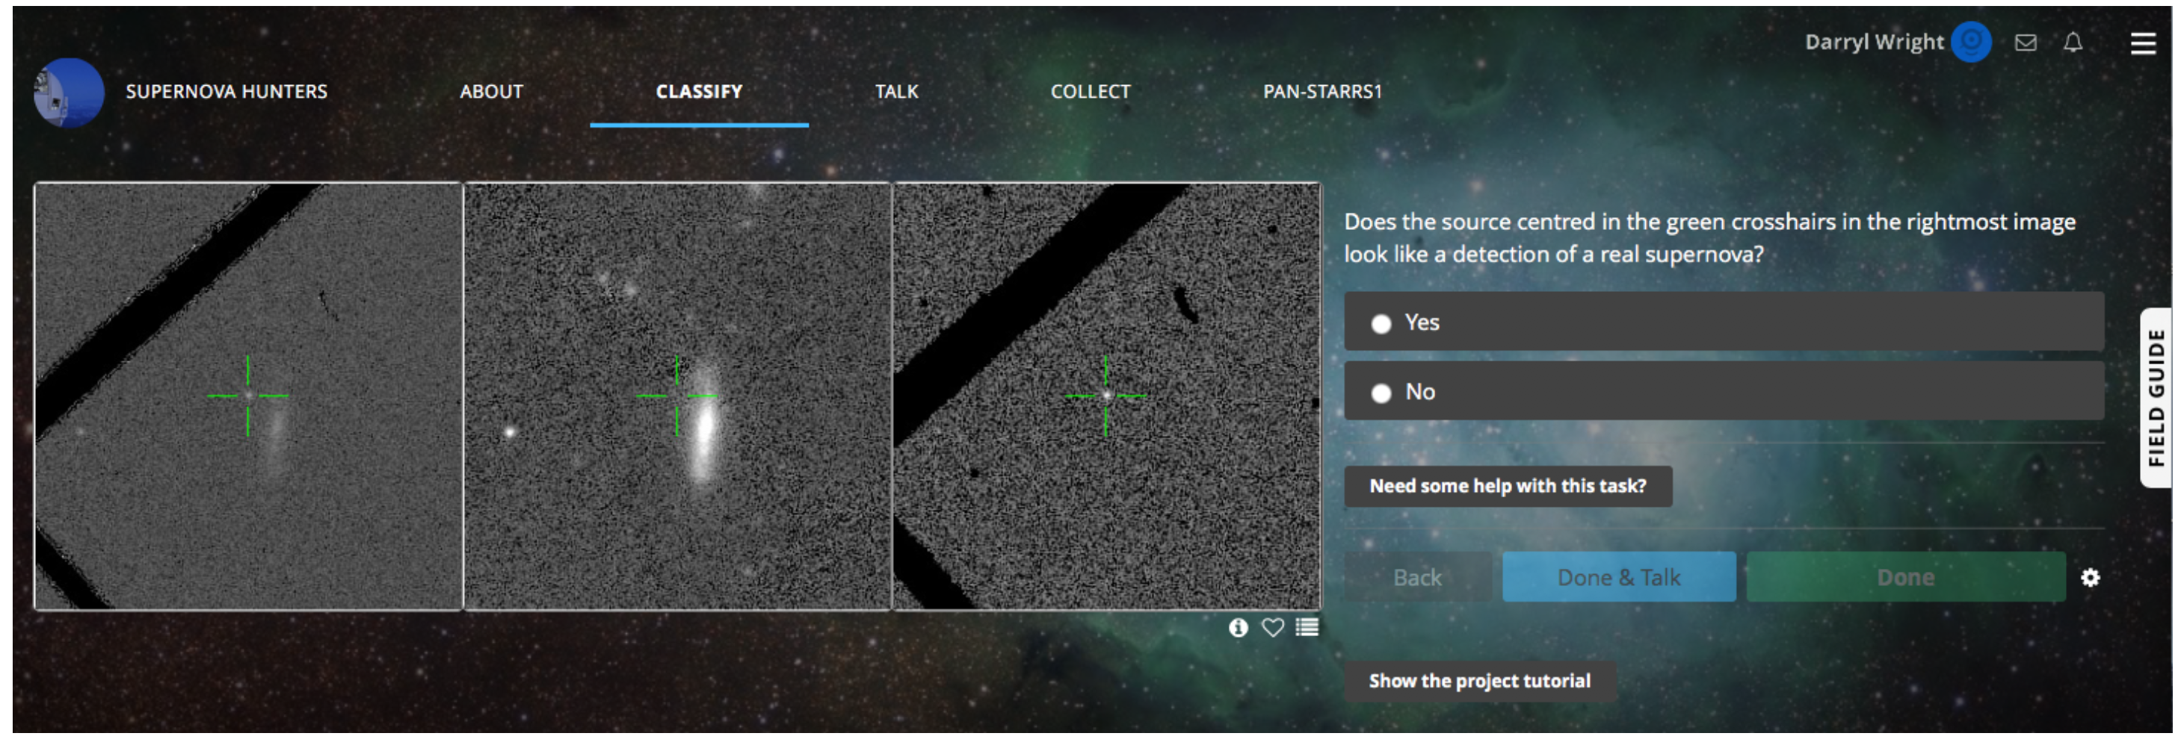
D. Wright et al (2017)
Notes:
Darryl works on a Zooniverse project called Supernova Hunters, trying to get volunteers to discover supernova. People are shown a before, after and residual image, and asked – does this look like a real supernova?
As well as asking people, he makes a separate prediction with a convolutional network trained on expert data. So he gets two independent predictions for each transient – one from the volunteers, and one from his model.

Slide 13
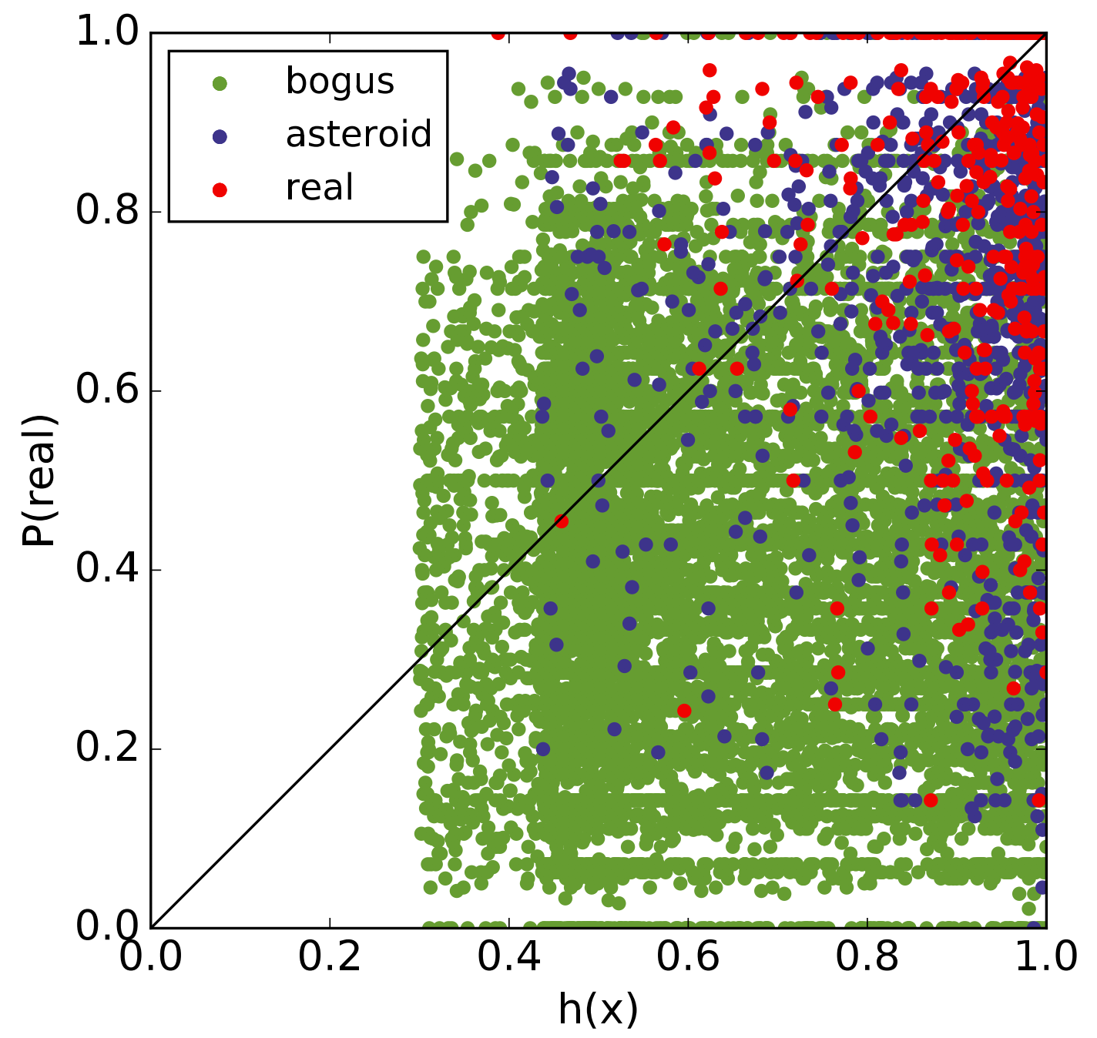
Human/Machine Ensemble
D. Wright et al (2017)
Expert-trained CNN + crowdsourced answers
Outperforms either alone
Notes:
Here are those predictions. On the x axis is the how much the model thinks it’s a supernova. On the y axis is how much the volunteers think it’s a supernova. Each point is a transient, colored by the true label. SN are in red, asteroids are in blue, and anything else is green. And for this, let’s just say asteroids are SN. We can tell them apart later because they move.
You don’t need me to tell you the metrics to see how the expert-trained model combined with the volunteer labels outperforms either alone. If I want to make a cut on here to separate out SN, a diagonal line using both predictions is going to give the best result.
*pause* Why? *pause* Why should they work well together? We know that people are good at learning from very few examples, so perhaps they’re doing well at identifying rarer transients. Inversely, machine learning models are good at learning subtle variations in large amounts of data, so perhaps they’re doing well at distinguishing between common transients.

Slide 14
1. Now(ish): Human → Model
2. Human + Model?
Notes:
Supernova hunters is an early example of using humans and models as separate classifiers.
Now, I like the principle – the idea that humans and the model can support each other because they have different strengths. But I’m reluctant to build something for Galaxy Zoo that relies on a model trained with expert labels.
So I’d like to suggest a third approach.

Slide 15
1. Now(ish): Human → Model
2. Human + Model?
3. Human ←→ Model
Notes:
This is what I’m working on. Trying to build feedback loops between the humans and the model. *pause*

Slide 16
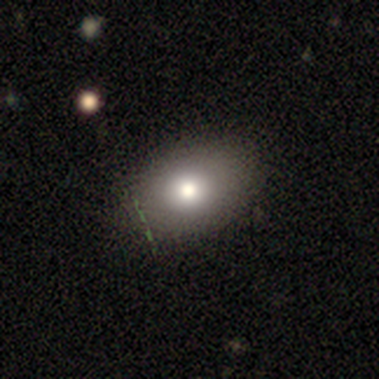
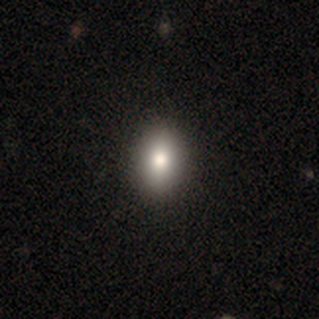
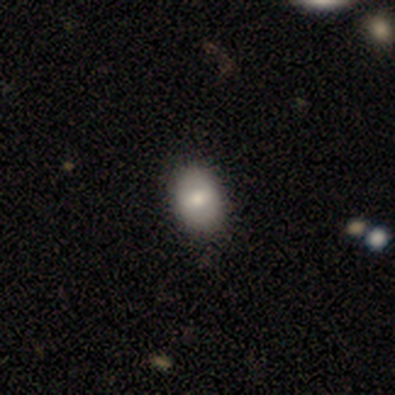
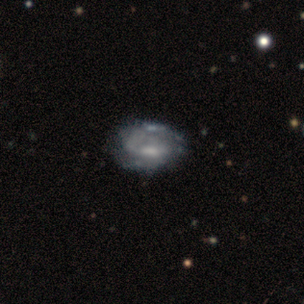
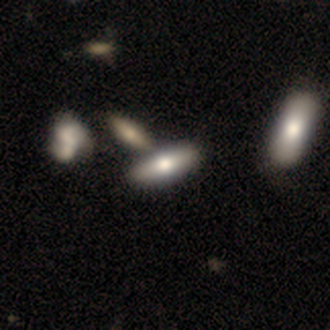
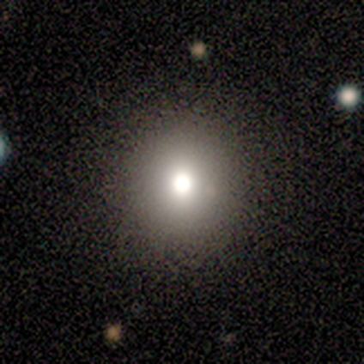
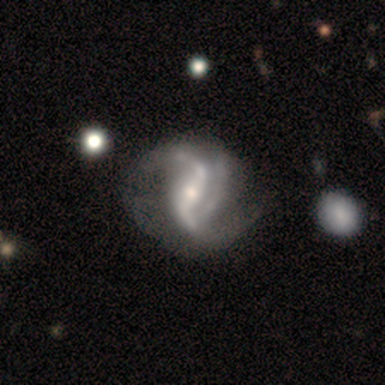
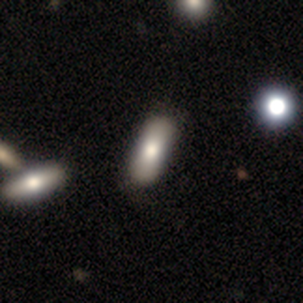
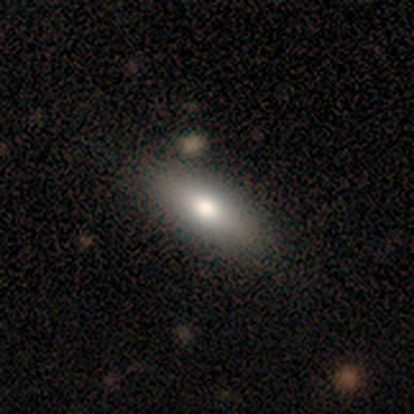
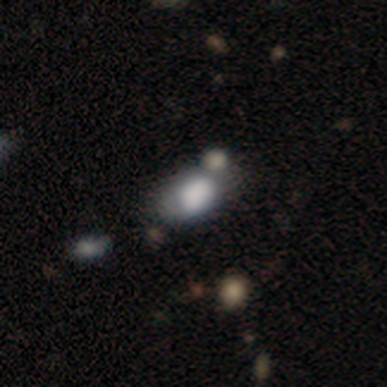
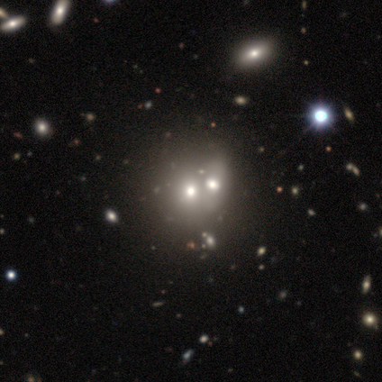
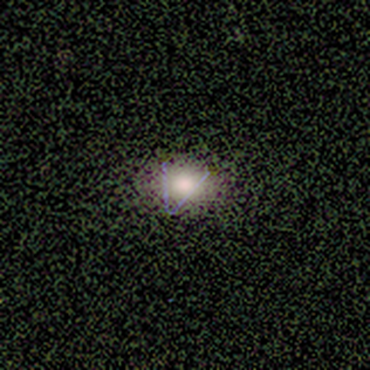
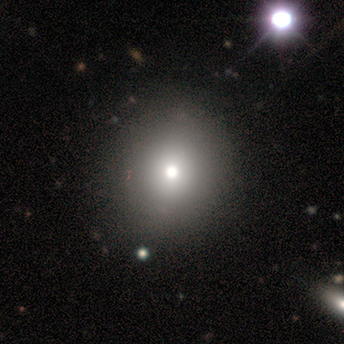
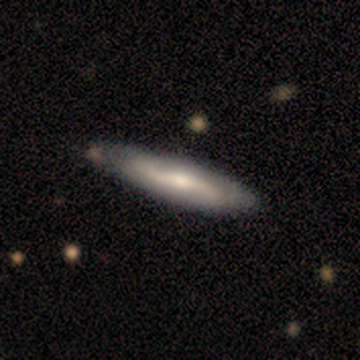
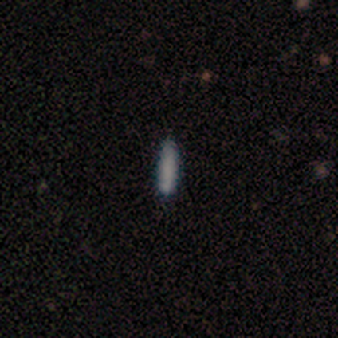
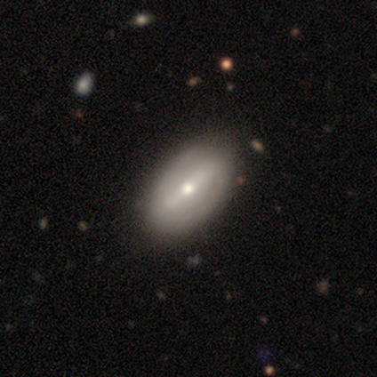
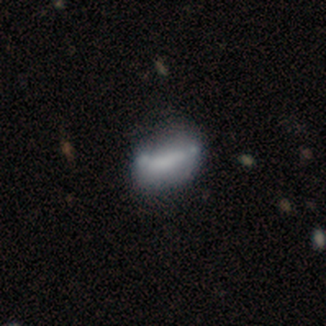
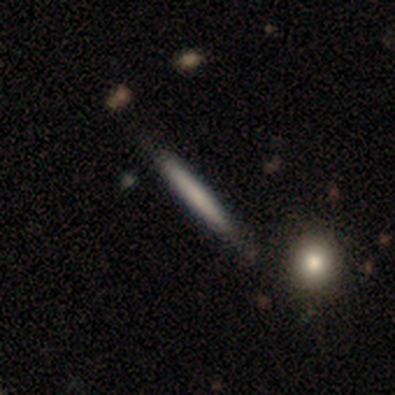
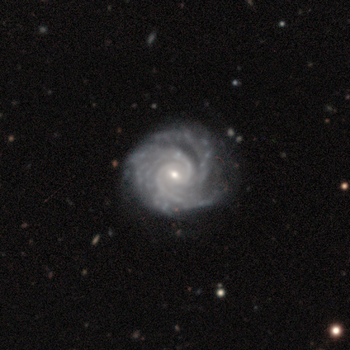
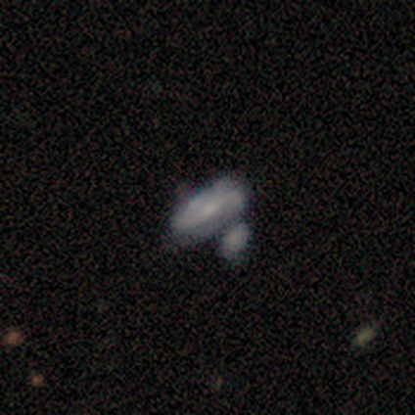
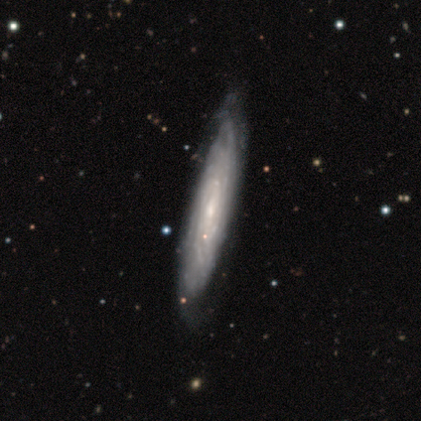
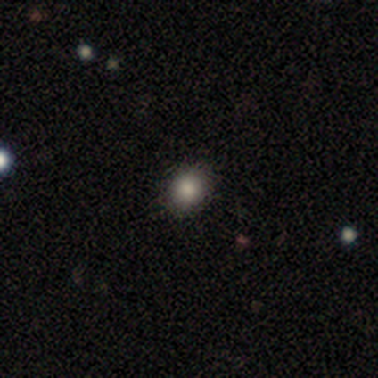
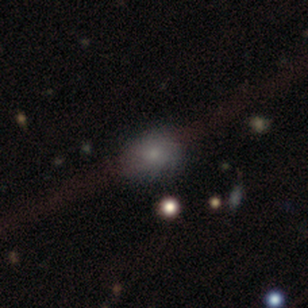
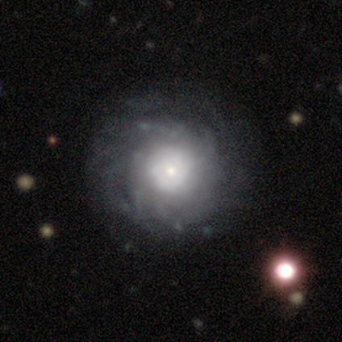
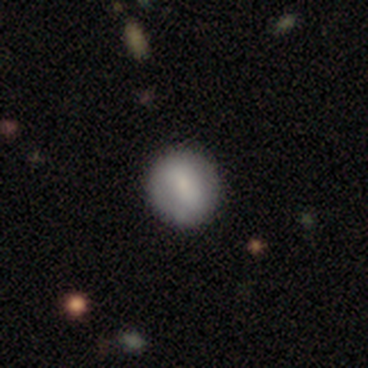
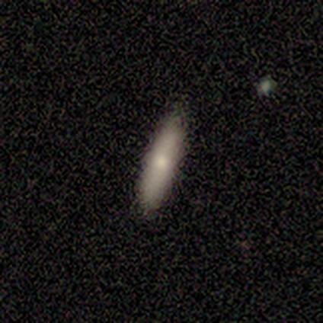
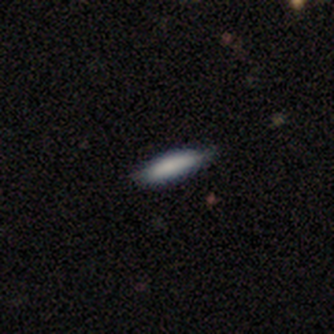
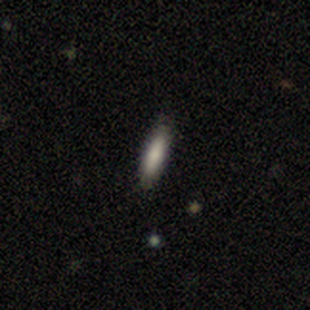
Notes:
Here are the first 28 galaxies in DECALS, the survey I’ve uploaded to Galaxy Zoo.
About a third of these galaxies – are boring. *pause*.

Slide 17
Notes:
They are! From a machine learning point of view, we would expect any model to learn to recognize these after fairly few examples.
But right now, we’re still showing hundreds of thousands of these to humans. That’s not efficient. And it’s not fair on our volunteers.
Ideally we would only show the volunteers the images that the model most needs help with. The model should be able to ask – hey, I’m really uncertain about these galaxies – can you label them for me please? Then the humans would label them, the model would retrain with only those most informative galaxies. This is called active learning.
The catch is – how do we know which images the model is uncertain about? Deep learning only gives you a scalar prediction for each class. But what we really want to know is the uncertainty around that prediction.

Slide 18
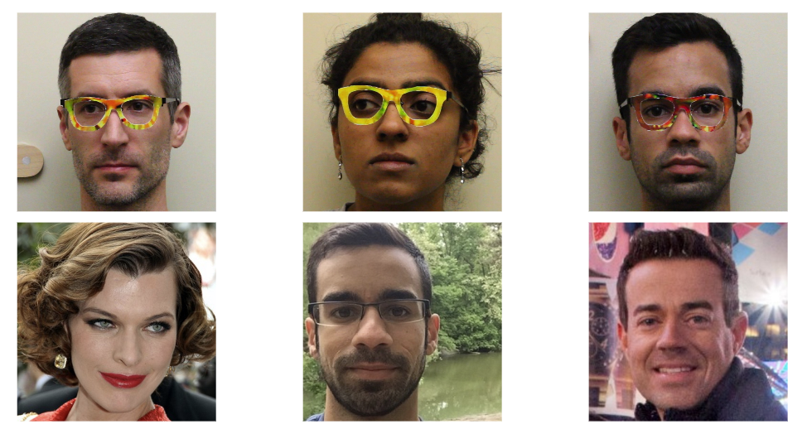
Adversarial Examples
Wear frames
Appear as
Sharif, M., Bhagavatula, S., Bauer, L., & Reiter, M. K. (2016)
Notes:
It turns out that computer science folks are interested in this as well. Check this out. This researcher has 3D printed a pair of colored frames that make a facial recognition algorithm think he’s a celebrity.

Slide 19
Adversarial Examples
Wear frames
Appear as
Sharif, M., Bhagavatula, S., Bauer, L., & Reiter, M. K. (2016)
Notes:
And you can do this for any celebrity – here’s another researcher doing the same thing. And here’s another -

Slide 20
Adversarial Examples
Wear frames
Appear as
Sharif, M., Bhagavatula, S., Bauer, L., & Reiter, M. K. (2016)
Notes:
- impersonating the first one! *pause*
This is a cute example of a serious problem, that we talked about this a bunch in the discussion section yesterday.
More serious: Berkeley researchers developed stickers, about this big, that make stop signs get classified as bottles. If you’re in a self-driving car, that’s a problem.]
To defend against this, CS people have been trying to make deep learning methods that can quantify uncertainty. And we can use that.

Slide 21
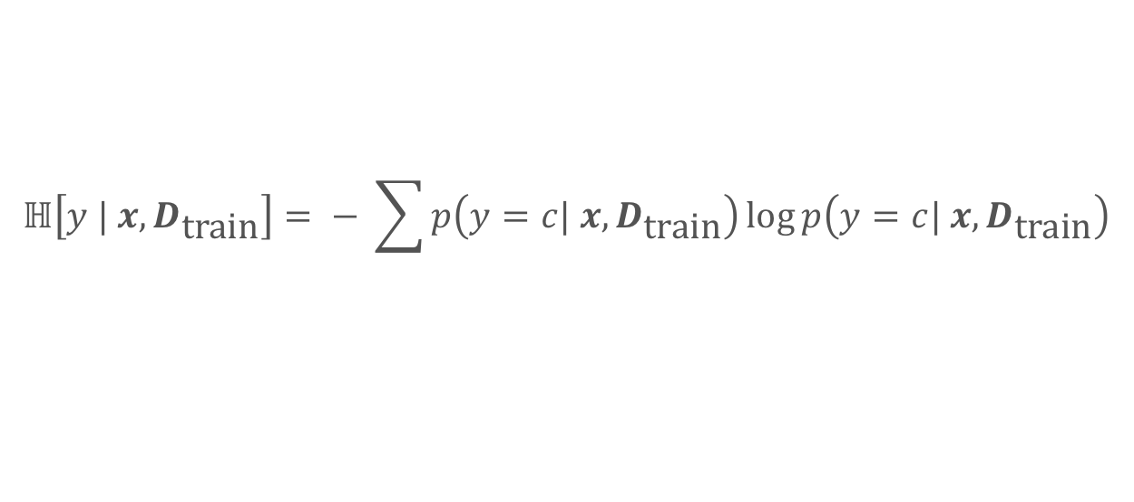
Active Learning
Active Learning Acquisition Function – Predictive Entropy
$$ℍ\left[y | x, D_{\text{train}}\right]= − \sum{p\left(y=c| x, D_{\text{train}}\right)\log{p\left(y=c| x, D_{\text{train}}\right)}}$$
Notes:
If we know the distribution of reasonable scores, we can quantify uncertainty. We might measure the entropy, for example – p log p, where each p is how likely you are to predict each label given the subject and the training data.
The hard part is finding p.

Slide 22

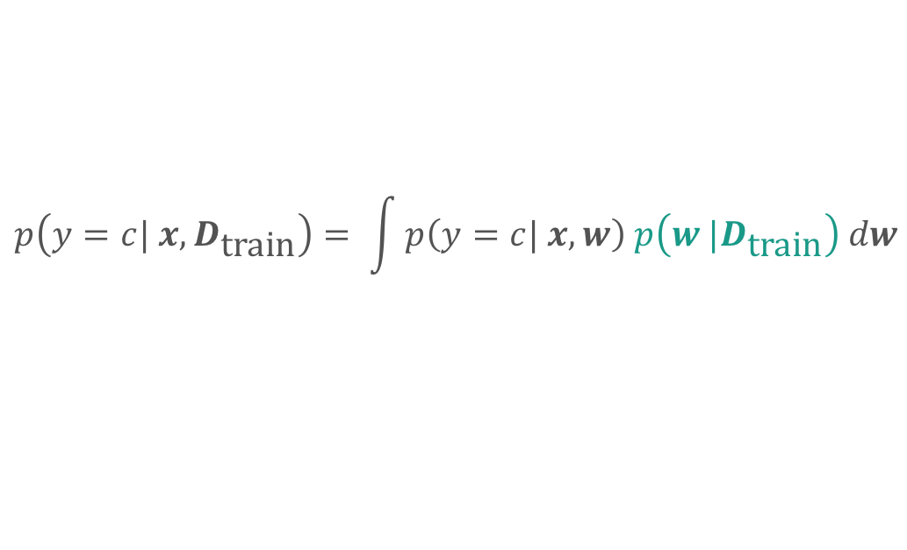
Active Learning + Bayesian CNN
Active Learning Acquisition Function – Predictive Entropy
$$ℍ\left[y | x, D_{\text{train}}\right]= − \sum{p\left(y=c| x, D_{\text{train}}\right)\log{p\left(y=c| x, D_{\text{train}}\right)}}$$
Estimating $p$ with Dropout – Bayesian CNN
$$p\left(y=c| x, D_{\text{train}}\right)= \int{p\left(y=c| x, w\right) p\left(w |D_{\text{train}}\right) dw}$$
See Y. Gal et al (2016)
Notes:
In principle, we know p from this integral – the probability of getting a set of weights, a model, that gives this prediction, marginalised over all the possible sets of weights we might learn from the training data. But we can’t solve this integral because we don’t know how likely each model is. We only know the model that we trained.

Slide 23
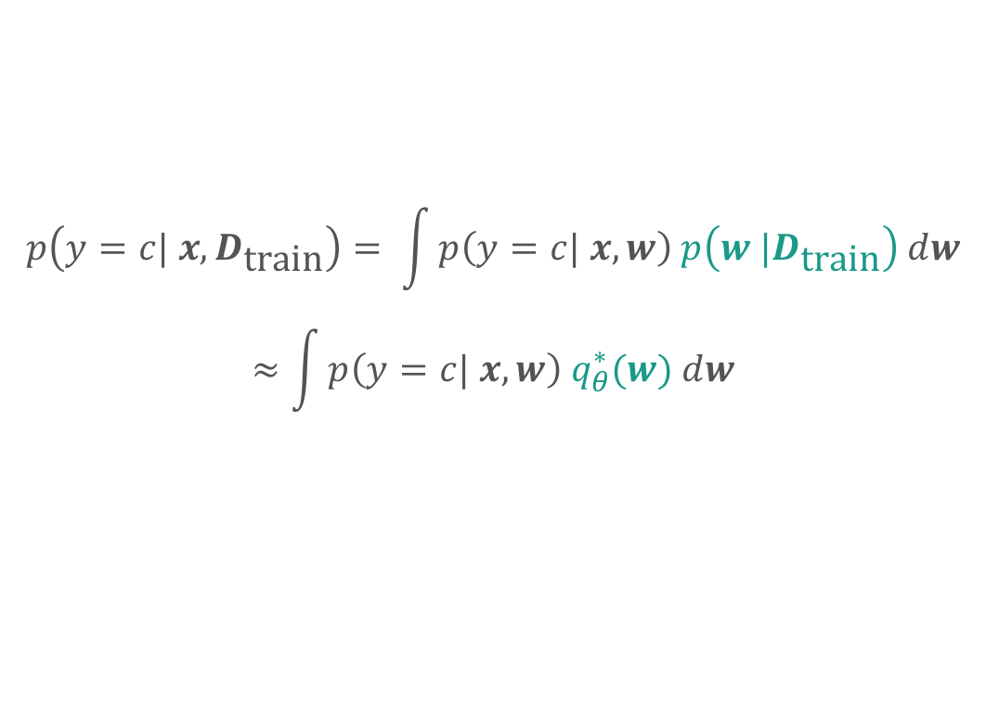
Active Learning + Bayesian CNN
Active Learning Acquisition Function – Predictive Entropy
$$ℍ\left[y | x, D_{\text{train}}\right]= − \sum{p\left(y=c| x, D_{\text{train}}\right)\log{p\left(y=c| x, D_{\text{train}}\right)}}$$
Estimating $p$ with Dropout – Bayesian CNN
$$p\left(y=c| x, D_{\text{train}}\right)= \int{p\left(y=c| x, w\right) p\left(w |D_{\text{train}}\right) dw}$$
$$≈\int{p\left(y=c| x, w\right) q_{θ}^{∗}(w) dw}$$
See Y. Gal et al (2016)
Notes:
Instead, let’s think about dropout. Dropout is when you pick a random selection of neurons, and you temporarily remove them from the network. It's like taking the network you've trained, and permuting it into a slightly different one.
Let’s approximate the models that we could reasonably have trained POINT with the models that we get from applying dropout POINT

Slide 24
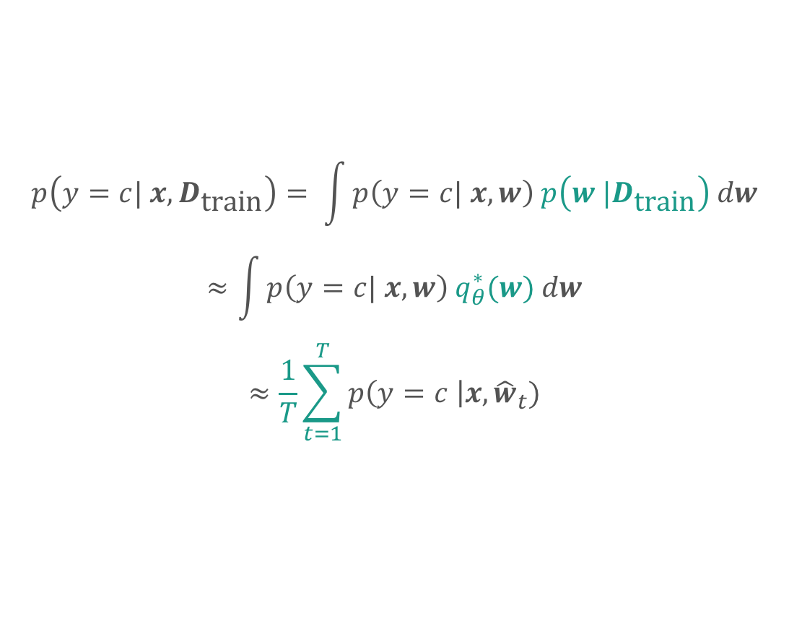
Active Learning + Bayesian CNN
Active Learning Acquisition Function – Predictive Entropy
$$ℍ\left[y | x, D_{\text{train}}\right]= − \sum{p\left(y=c| x, D_{\text{train}}\right)\log{p\left(y=c| x, D_{\text{train}}\right)}}$$
Estimating $p$ with Dropout – Bayesian CNN
$$p\left(y=c| x, D_{\text{train}}\right)= \int{p\left(y=c| x, w\right) p\left(w |D_{\text{train}}\right) dw}$$
$$≈\int{p\left(y=c| x, w\right) q_{θ}^{∗}(w) dw}$$
$$≈\frac{1}{T}\sum_{t=1}^{T}{p\left(y=c \right|x, {\hat{w}}_{t})}$$
See Y. Gal et al (2016)
Notes:
Now we can simply find our prediction distribution by sampling.
We apply dropout many times, and record each prediction.

Slide 25
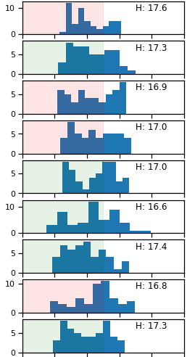
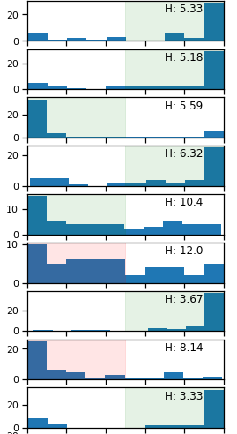

Results
Entropy $ℍ$
Untrained
Trained
We know when the model is uncertain
Samples
Samples
p(y = c)
p(y = c)
Notes:
Here’s what that looks like for galaxy classification.
Each row is a galaxy. The histograms are the distribution of predictions that I can measure with dropout. The color indicates the expected prediction and whether it was right or wrong.
On the left is the distribution of predictions very early in training. All clustered around 0.5.
On the right is the distribution of predictions for the trained model.
Here, it mostly predicts not C, but is very uncertain about it, gets it wrong.
And here, a model that mostly predicts C, is much more confident about it, and gets it right. That’s the pattern we’d hope to see.
Pause
By using dropout to approximate training many models, we now know when the model is uncertain. We can use this to pick the most informative examples.

Slide 26
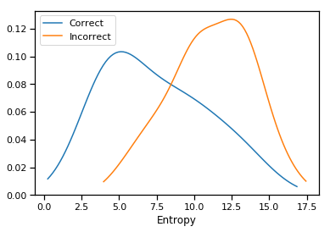
Results
We know when the model is uncertain
The model is more likely to be wrong on uncertain images
P(Entropy)
Entropy
Notes:
We can verify that this is actually working by comparing the entropy for images which the model gets right and wrong.
X
Y

Slide 27
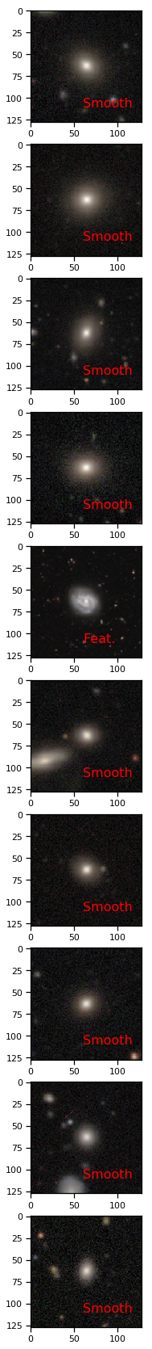
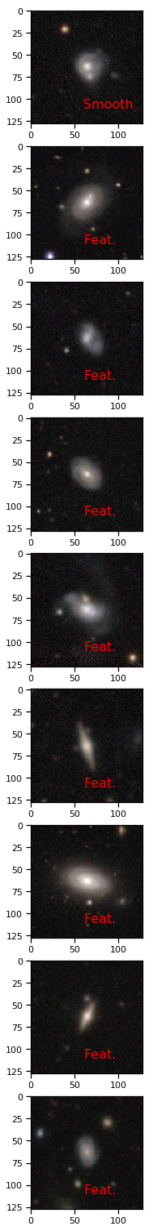
Top 9 Confident
Top 9 Uncertain

Slide 28
1. Now(ish): Human → Model
2. Human + Model
3. Human ← → Model
Notes:
Summarise. Classic -> tidal. Human + model + Darryl. Combined: active learning. Quantifying uncertainty, I hope, will let me pick out the most informative examples, build better models and give you the best possible galaxy classifications.
I think that this is something of a shift in philosophy. We’re not data scientists – we’re scientists. We’re not just handed a set of labels and told to build a model – we have choices about what to measure, what to follow up spectroscopically, in my case what images to show volunteers. Lets use that freedom to do better science. Thank you.

Slide 29
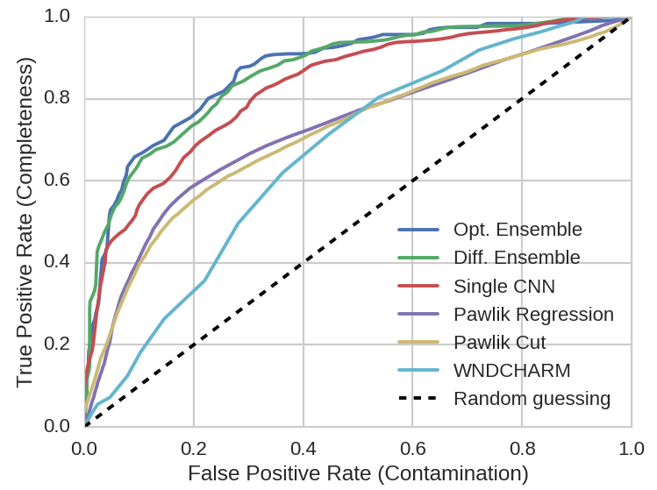

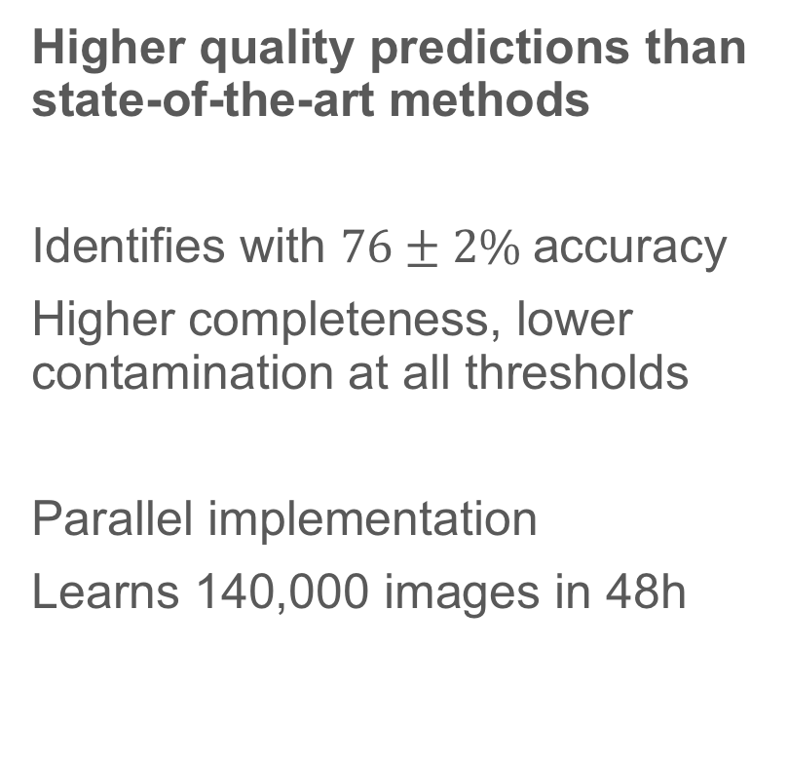
Does it work?
Higher quality predictions than state-of-the-art methods
Identifies with $76±2\%$accuracy
Higher completeness, lower contamination at all thresholds
Parallel implementation
Learns 140,000 images in 48h
Notes:
Does it work? Happily, yes.
To test how well it works, I replicated two methods currently used by astronomers on the same dataset.
The first method, called wind-charm, is a general purpose machine learning tool first developed for medical images and later applied to galaxy classification. It measures over 1000 properties of every image, such as the total brightness, and decides which are the discriminatory by trying to separate classes with planes in this very high-dimensional space.
The second method, by Pawlik and published in 2016, is a classic rule-based astronomy approach. Pawlik measures the asymmetry of the galaxy, and the asymmetry of the binary mask of that galaxy – just like the masks I used when removing interlopers. Galaxies with both a high asymmetry and a high mask asymmetry are usually tidal.
Here’s how each method performs on the same data. The y axis measures how many galaxies which really are tidal are correctly classified as tidal – the completeness of the classifier. The x axis measures how many galaxies which are incorrectly classified as tidal, when they are actually not – the contamination. Each line is generated by varying the threshold at which each continuously-valued prediction is considered to be tidal.
A perfect classifier would be completely in the top right: 100% completeness and 0% contamination. In light blue is windcharm. It does better than random chance, but it’s not great – probably because of the faintness of the tidal features and the complexity of each galaxy. In yellow and purple are two slightly different versions of Pawlik. Pawlik does quite well and largely outperforms windcharm, but there’s still a lot of room for improvement. In red is a single one of my convolutional neural networks. It already outperforms both Pawlik and windcharm. In green and blue are two ensemble classifiers. The ensemble approach improves on the single network and outperforms both Pawlik and windcharm by a significant margin.
Astronomers can choose the completeness they like, but at the cost of contamination. For example, if you would like a sample of tidal galaxies with a completeness of 75%, containing 3 quarters of all tidal galaxies, you would have a contamination rate of 50% with windcharm and pawlik, but only 30% with a network and only 20% with an ensemble.
By using convolutional neural networks, I’ve built a classifier that can automatically identify tidal features with significantly higher accuracy than the methods astronomers currently use. An effective automatic classifier removes the need for tedious and subjective visual inspection, and allows for much larger samples of tidal galaxies to be generated. My method scales well through parallel design, and can learn from 140,000 images in 48 hours with very moderate HPC resources. Large samples of tidal galaxies with high completeness and low contamination will provide the statistical power that astronomers need to make reliable inferences on the properties of merging galaxies, and on the impact of mergers on galaxy evolution.
I’m excited to continue this work for my PhD. Having proven the method on previously classified galaxies, I would like to apply it to new wide-field surveys like KIDS. There’s also one unique advantage to my method that I’m keen to develop.

Slide 30
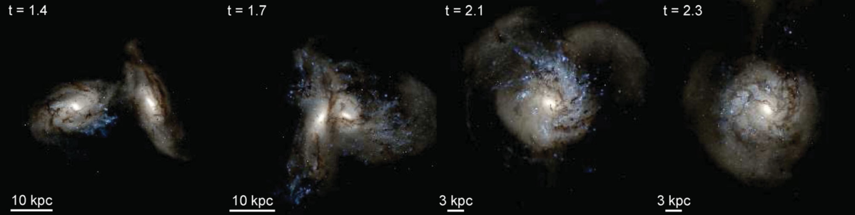
Credit: P Hopkins et al (2013)
Notes:
This is a simulation of two colliding spiral galaxies, of equal masses. It looks about as dramatic as you would expect. You can see that disturbances to the shape of the galaxy remain visible, albeit fainter, for quite some time after the nuclei have merged. Look how these arm-like features remain in the final panel. Such disturbances are called tidal features.
Mergers are important to study for both their impact on galaxy evolution, and as probes of the properties of the merging objects. By counting tidal galaxies and measuring their properties, you can make inferences about what the objects that merged were like.
For example, we observe that more spiral galaxies have tidal features than elliptical galaxies. [timescale?] Spirals have a higher gas content than ellipticals, leading to more star formation being triggered by the merger and a longer timescale over which tidal features can be detected following a merger – raising the number count. By counting the ratios of galaxy types with tidal features, you are measuring the relative gas contents of those galaxies. That’s one way in which samples of recently merged galaxies are useful astrophysical probes.
The hard part is being able to identify enough galaxies with tidal features to make statistically significant inferences. For the paper on measuring gas content that I just summarized, researchers went through 3000 galaxies by eye and decided if each one had tidal features or not. Visual inspection isn’t great – it’s subjective, it’s hard to reproduce, and most of all it doesn’t scale. There are not enough grad students in the world to inspect a significant fraction of the galaxies that new wide-field surveys like LSST are expected to reveal.
Why did the researchers use visual inspection then? Because automatically detecting tidal features is difficult to do effectively. That’s because what we really observe looks like this:

Slide 31
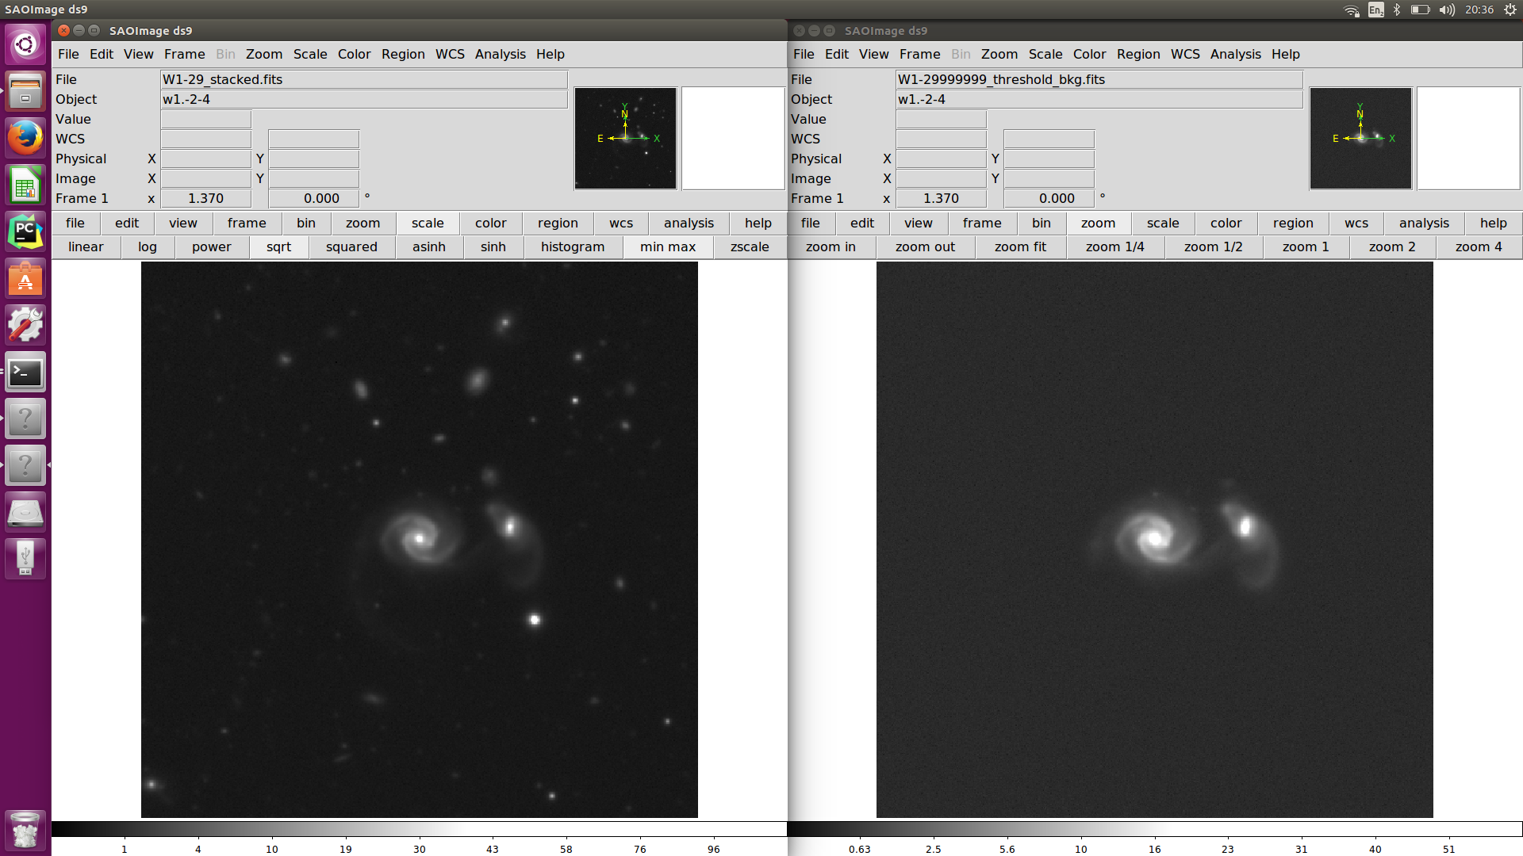

Pre-process images
Before
After
Stack bands
Estimate background $\left\langle x\right\rangle$ and $σ$
$3x3$ mean convolution
Create binary mask
$$M_{ij}=\left[ x_{ij}>\left\langle x\right\rangle + Nσ \right]$$
Select only centrally 8-connected region
Dilate mask (disk element)
Smooth mask (15x15 conv.)
Fill mask with stacked bands
Fill inverted mask with synthetic background
$$y_{ij}= M_{ij}x_{ij}+ M_{ij}^{−1}b_{ij}$$
Notes:
Aim to cut down noise
SExtractor is quite bad at this

Slide 32


All Together: Network Architecture
Convolutional Layers
Fully-Connected Layers
$x_{j}^{(l)}=f(\sum_{i}{w_{i,j}^{(l)}∗ x_{i}^{(l−1)}}+b^{(l)}$)
$x^{(l)}=f(w^{\left(l\right)}x^{\left(l−1\right)}+b^{(l)}$)
1
3
0.56
2
Notes:
You can group neurons together in layers and then have the output of a neuron in one layer be the input for a neuron in the next. You would plug in the pixel values for your galaxy image into the neurons in the first layer, and then use the output of the first layer as the input for the second. And so on.
If you construct your neurons so that the final layer outputs a single number between 0 and 1, you can interpret that as a prediction: a probability for your input galaxy having tidal features, in our case.
Why should that number have anything to do with making a prediction? We can optimize the weights and biases such that they minimise an objective function that measures how inaccurate the predictions are. Try some parameter values, see how the prediction quality changes, pick some new values, repeat.

Slide 33

How To Train Your Dragon Network

Slide 34

Making It Work: Regularization Effectiveness
Without Regularization
With Regularization
Notes:
Here’s what happens when you train two otherwise identical networks with and without all these tweaks.
The y axis measures the network accuracy: how often it correctly predicts the class of an image. The x axis measures how many randomly transformed examples the network has been shown. One epoch means 1000 training images.
The red lines plot the accuracy the network has on the images it’s being trained on. After 80,000 images, it reckons it can pick out tidal galaxies correctly 98% of the time. However, when you periodically show the network new unseen images that it hasn’t been trained on, the real accuracy is more like 65%. The network is learning the noise in the training set rather than genuinely discriminative features.
However, using the tweaks just outlined, the network does much better. It achieves a real accuracy of about 77%, and the accuracy on training and test sets match well.

Slide 35

The Project
Goal
Use machine learning to automatically identify galaxies with tidal features
Approach
Download telescope images
Code neural network
Refine design e.g. regularization
Ensemble: aggregate predictions of many networks
Reproduce current methods and compare accuracy
4.
Credit: Atkinson 2013
Notes:
My task was to find a way to automatically classify galaxies as being tidal or not, and to verify my method by comparing my predictions with those of the researchers. Because the previous MPhys project had failed to use traditional rule-based programming to solve the problem, it was suggested that I use machine learning. The most important thing to know about machine learning is that it’s learning by example. You show the machine many examples of each class, and it tries to identify patterns, rather than you simply telling it how to classify each image.
To classify the galaxies, I chose to use a machine learning technique called convolutional neural networks. Convolutional neural networks are the state-of-the-art approach for image classification in computer science, and I’m going to spend a big chunk of this talk on the computer science aspect of how they work. That’s because a big chunk of my project was (F) learning about these networks, (F) implementing them in python, and (F) tailoring them for this astrophysics problems.
Part of that tailoring involved making the network work on such a small dataset. 1800 images might not sound small, but convolutional neural networks are usually used on datasets with millions of images. Think about detecting faces on Facebook, for example. I used regularization techniques to cope with having a very small dataset, and I’ll walk you through what those are.
To boost my classification performance, I use ensembling. If you train many networks, and aggregate their predictions, the aggregated predictions will outperform those of a single network. I’ll explain why that is and how you can do it in practice.
Finally, I reproduced two methods currently used by astronomers and applied them to the same dataset to see how my method compares.

Slide 36


Slide 37


Slide 38

Varied Classifiers
Optimal Classifiers

Slide 39


